Slide 1
Ideas for value creation in healthcare construction in turkey

Slide 2
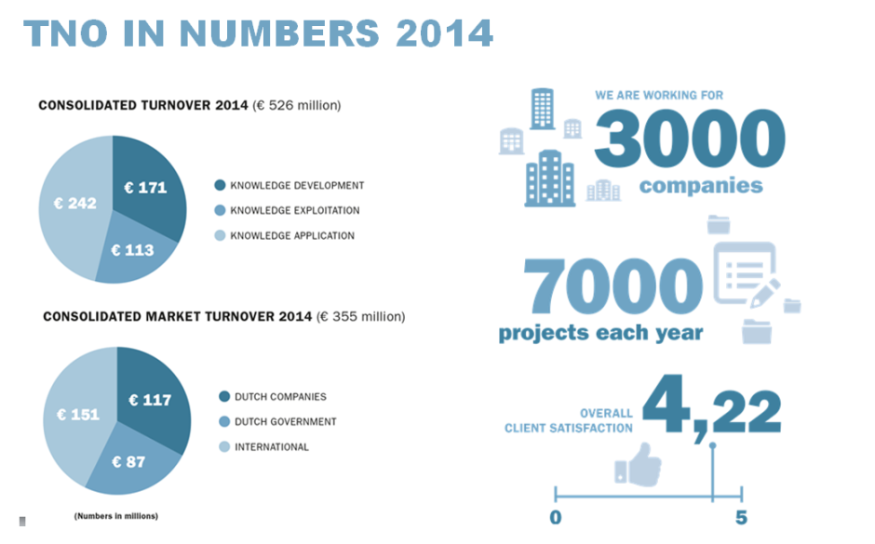
Tno in a nutshell

Slide 3
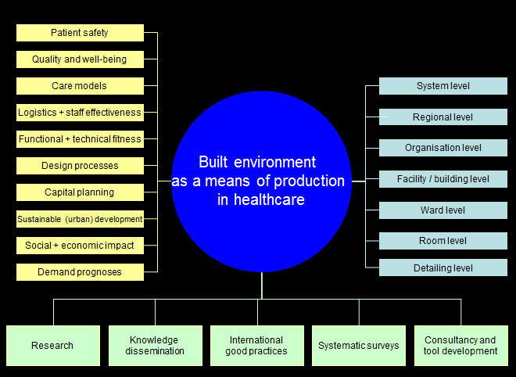
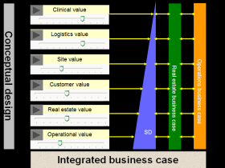
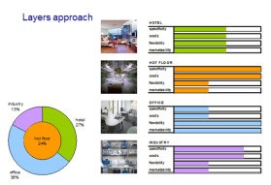
Conceptual approach

Slide 4
Why this presentation?
TNO is the Netherlands’ largest Research and Technology organisation
It works with universities, governments and business on research, development and market implementation of innovations.
Turkey is a strategic priority for TNO to expand its international operations. We already cooperate with the Turkish research institute Tübitak, and collaborate with research and industry partners in projects in various domains
Healthcare environments design and construction is a domain where TNO has a unique portfolio of expertise and experience
We are looking to establish relations with Turkish partners working in this field, to establish collaborations for mutual benefit
This presentation gives a brief introduction to five areas where TNO is looking for collaboration with partners in Turkey.
Key Performance Indicators
Core Function Concepts and Designs
Hot Floor Logistics
Operating Theatre Safety
Circular Economy Solutions

Slide 5
Tno offers highly qualified help
TNO has a long-term history and an extensive international network in hospital planning, design and construction. TNO can provide reference designs that showcase the current state-of-the-art. And we can help you decide how to include the best from elsewhere in your own project
Making good planning and design decisions means forecasting their effects. TNO offers a range of evidence-based modelling and simulation tools to support your decision making. From high level options analysis and long-term demand prognoses, to innovative integrated Building Information Management solutions
Large hospital projects require substantial investment and have a huge impact on future financial performance. TNO has developed a range of business case analysis instruments. These are specifically designed to help decision making in complex situations, where there are many unknowns and stakeholder groups.
Acces to evidence
Models and simulations
Business case analysis
How do you define what your new hospital and hospital building need to do? And how do you use that information to manage the design and
development process? TNO can help you define key performance indicators for various performance domains, from staff efficiency to energy consumption. We can help you decide what are appropriate KPI’s for different design and
Development phases, and integrate these into effective assessment processes. Insight into financial performance KPI’s will help secure financing from bank and other financiers.
Performance Indicators

Slide 6
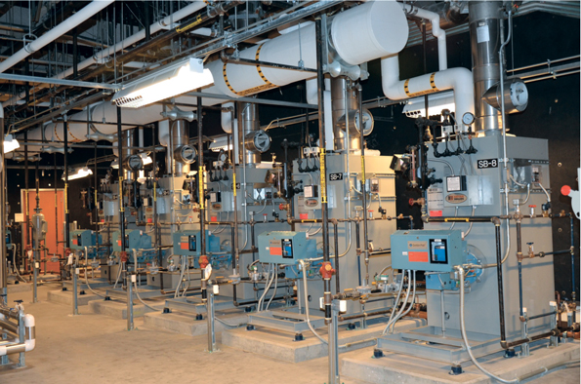
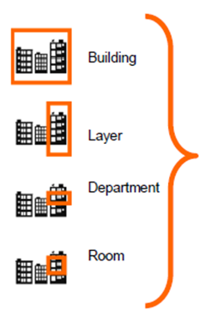
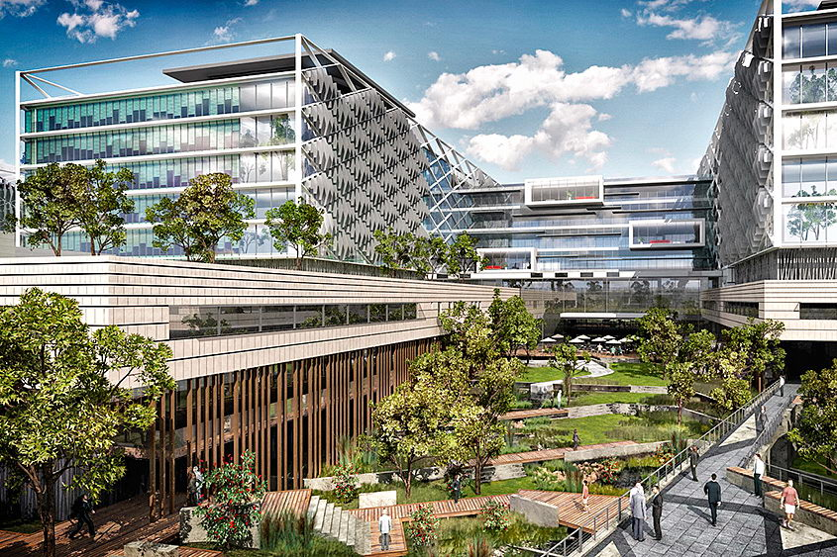
Key performance indicators
The Challenge
Predicting future performance of buil-dings is more and more important to win contracts and gain competitive edge.
But modelling building performance in early design phases is difficult. Especially for complex buildings like hospitals.
Designs have to satisfy many different sets of performance indicators, in different domains and at different scale levels. This creates design dilemmas and problems.
Current models and systems are not SMART enough. They cannot generate early design alternatives for optimisation.
Clients demand more and more assurances and guarantees on building performance. Winning contracts de-pends on meeting these demands. Non-compliance carries penalty risks.
Financial performance
Key Performance Indicators

Slide 7
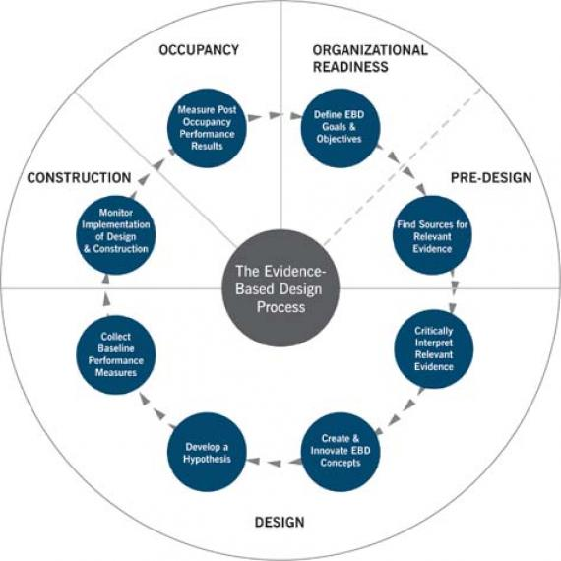
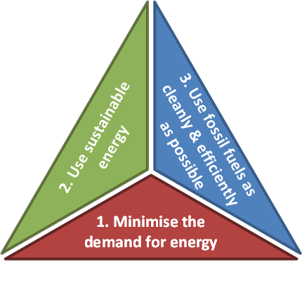
Key performance indicators
What can TNO bring?
Clients and partners
Collaborative innovation with design and construction industry worldwide
Hospitals starting on major building projects
Architects, designers and engineering firms looking to optimize design performance
Financiers and project developers needing to assess risks and strengths of proposed ventures
Bringing innovation to market to strengthen competitiveness
Extensive portfolio of research and innovation in BIM-based modelling and project management
Advising hospitals, governments and investors on major healthcare investment decisions
Automated and semi-automated early design generation and evaluation
Value creation
Define, design and monitor appropriate KPI’s using evidence-based healthcare design and advanced modelling
Improve end-user involvement and acceptance of design proposals
Assess and predict future hospital performance
Support and facilitate more effective design and build processes
Help secure capital funding at favourable conditions
Reduce fail costs and waste
FINANCIAL
ENERGY
PERFORMANCE
Source: Center for Health Design (USA)

Slide 8
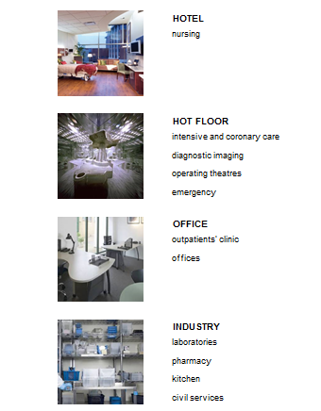
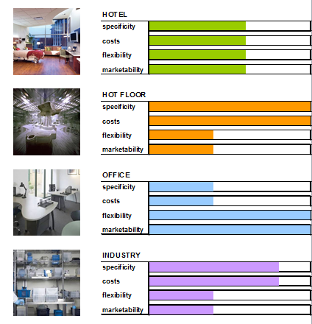
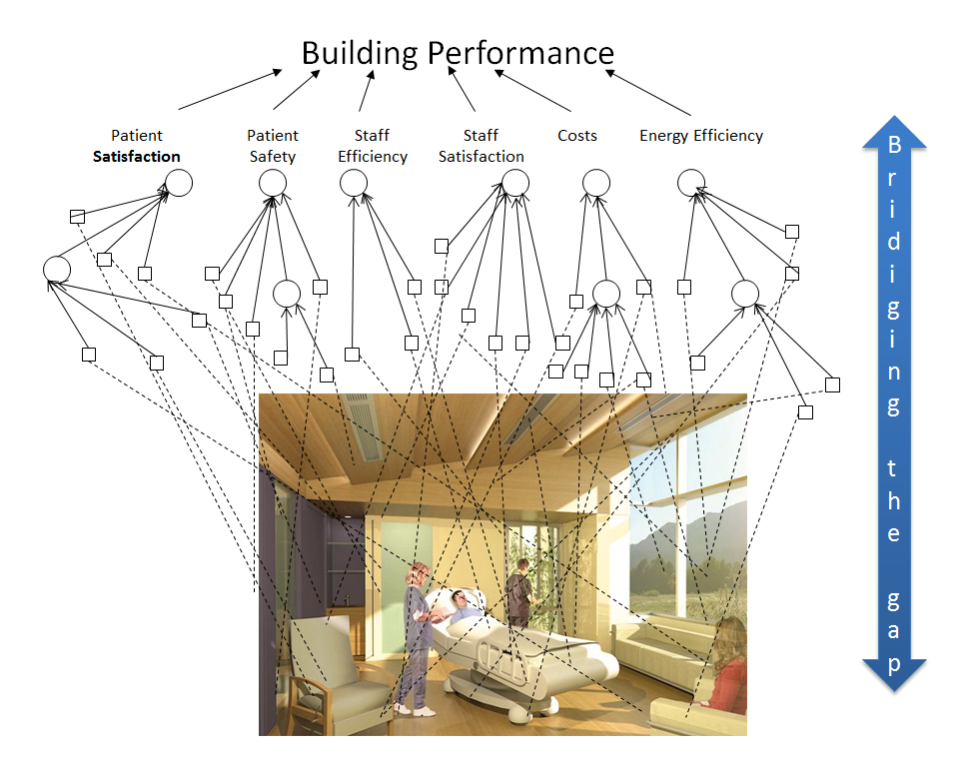
Core function concepts and designs
The Challenge
Changes in care models and technology demand building flexibility
Competitive market conditions demand performance excellence
Evidence is hard to find
There is no reliable way to tap into worldwide best practices
Evidence-based design excellence in key departments reduces costs and risks.
It gives a competitive edge in running hospitals and winning contracts.

Slide 9
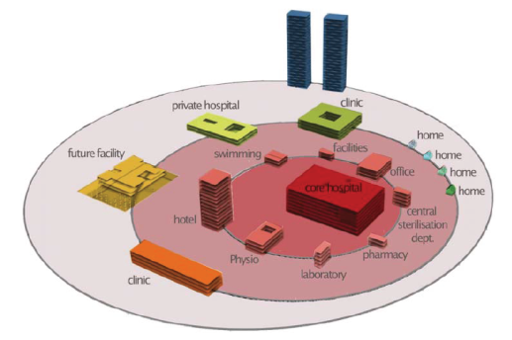
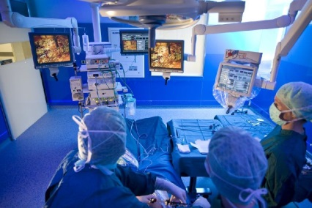
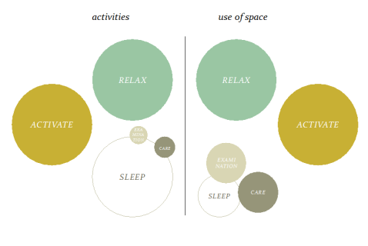
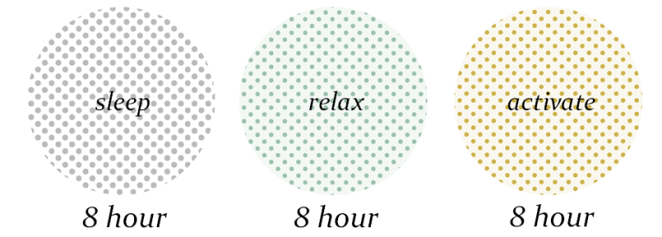
Core function concepts and designs
What can TNO bring?
Clients and partners
Hospitals
Architects and engineering firms
Specialist suppliers
Project developers
Flexibility in building portfolios using layers analysis
Value creation
Co-develop tailored concepts for Turkish markets
Support development of winning bids for contracts
Quantify and monetarize effects of design decisions
Support effective design & build processes by organising access to evidence and by validation of intermediate design proposals
Surgical department and operating theatre design and logistics
Inpatient ward concepts for better patient outcomes and increased turnover per bed

Slide 10
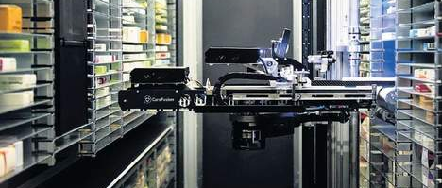
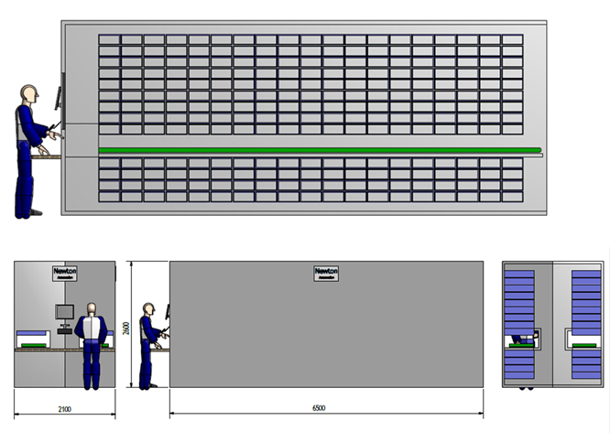
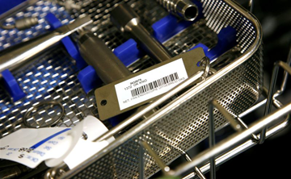
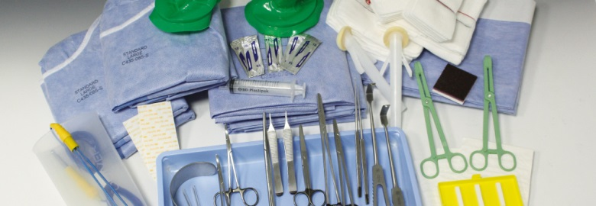
Hot floor logistics
The Challenge
Logistics flows for hospital core processes are complex and costly.
Economic gains from better solutions are large: research shows up to 30% potential.
Advanced solutions in other sectors offer new directions (robotics and automated systems)
But safety concerns, organisational and cultural barriers and healthcare sector conservatism stop improvements being implemented
Source: Newton Automation Ltd (NL)

Slide 11
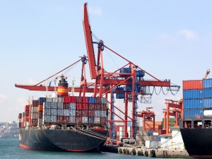
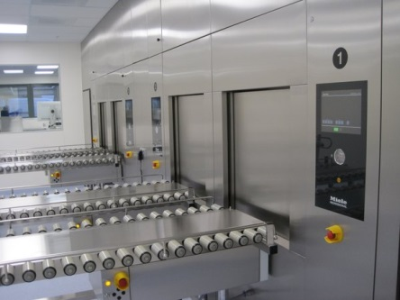
Hot floor logistics
What can TNO bring?
Clients and partners
Hospitals looking to optimize their hot floor logistics
Automated supply and robotics providers looking to enter the hospital market
Architects, designers and engineering firms facing supply chain design challenges
Extensive experience in preparing functional and technical briefs
Sophisticated logistical analysis tools and knowledge
Leading European player in supply chain logistics innovation. Track record in key sectors like ports and transport
Broad knowledge of healthcare organisational and safety concerns
Value creation
Recent research in automated surgical supply logistics
Application of state of the art logistical models to hospital use cases
Current logistical flow analysis to identify bottlenecks and improvement opportunities
Definition of implementation scenarios. Support implementation processes
Technical advice on systems requirements
Business case analysis using validated models
Dynamic, context-sensitive hospital logistical chain analysis
Technical conditions
Investments and pay-offs
Option selection tools
Implementation scenarios

Slide 12
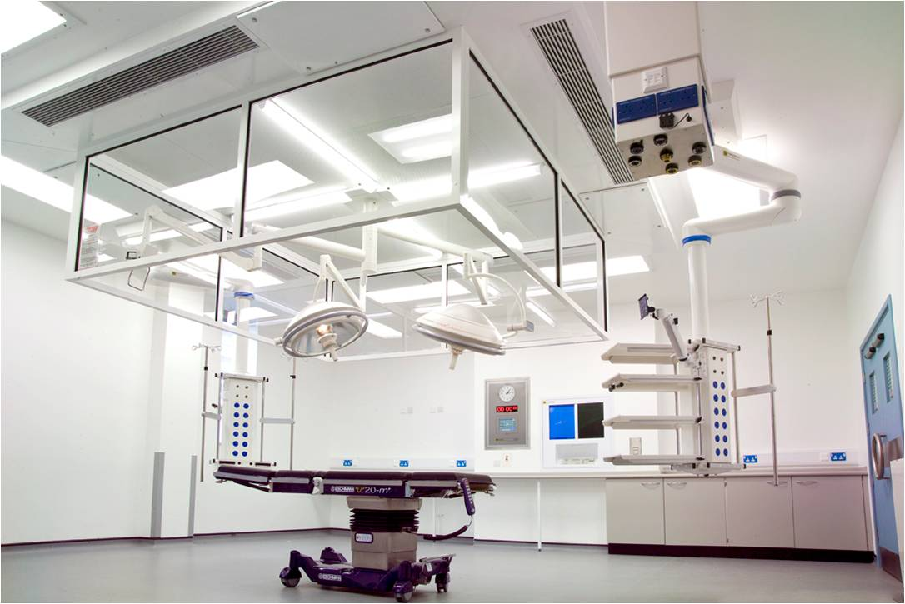
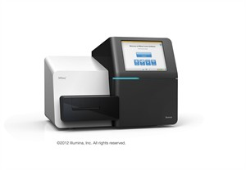
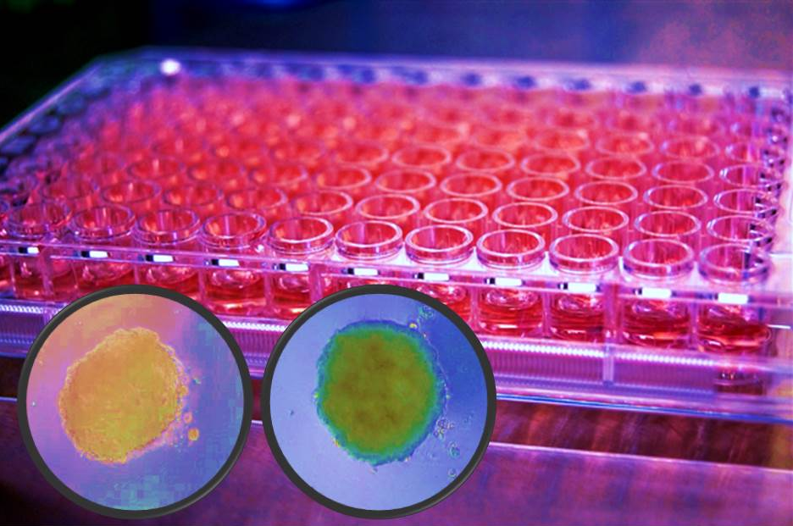
Operating theatre safety
The Challenge
Sterile conditions in operating theatres to prevent infections are a key driver for hospital performance
HVAC systems using HEPA filters and laminar flow are standard features of current theatres
But new techniques, equipments and spatial concepts put in doubt the reliability of HVAC system performance measurements
The microbiology of infection transmission in theatres is still poorly understood
There is a need for validated performance assessment using state-of the art technologies and microbiological techniques to guarantee the performane of all operating theatre systems

Slide 13
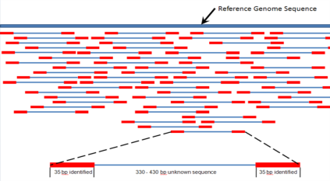
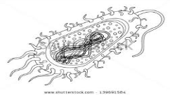
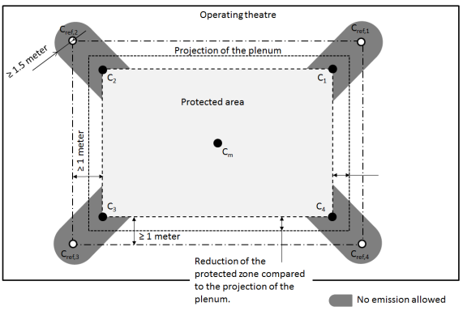
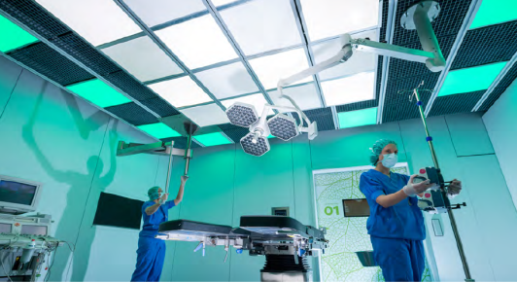
Operating theatre safety
Operating theatre safety
What can TNO bring?
Clients and partners
Hospitals concerned about operating theatre safety and performance
Suppliers of technical equipment and installations
Architects, designers and engineering firms facing tough requirements on operating theatre design
Mapping operating theatre microbial ecology using Next Generation Sequencing Meta-genomics
Assess HVAC systems performance using system and lay-out independent validated methods. Large portfolio of assignments in the Netherlands
Value creation
Operating theatre technical process analysis and improvement advice
Validate and measure current operating theatre performance
Understand and manage infection transmissio risks
Demonstrate compliance and safety equivalence to assessment bodies
Improve clinical performance and reduce infection rates
Predict performance of proposed design solutions

Slide 14
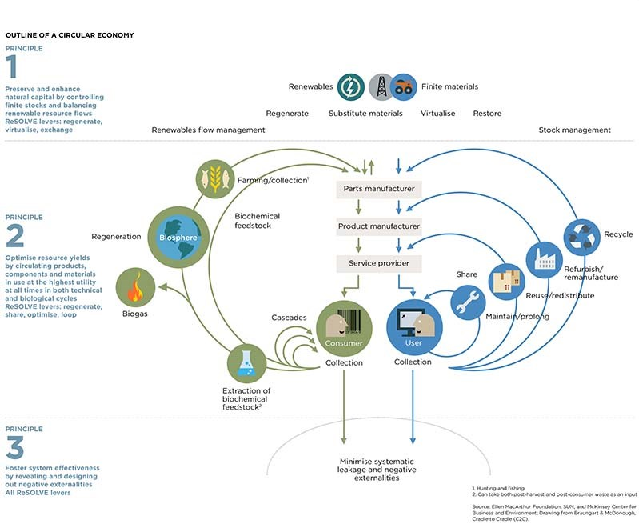
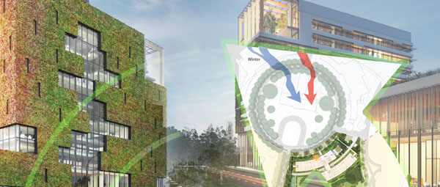
Circular economy
The Challenge
Re-use of materials is increasingly important to reduce environmental impact and avoid depletion of natural resources
Integrated production chain analysis is needed to close production chains and identify opportunities for recycling
Technological advances in materials re-use open up new, high-performance requirement sectors for circular approaches
But expert knowledge is needed to create framework conditions and capitalize on opportunities

Slide 15
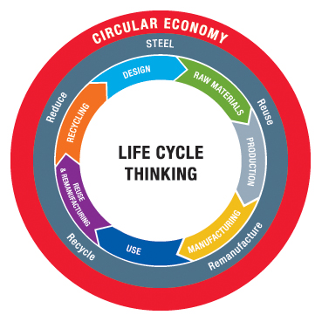
Circular economy
What can TNO bring?
Clients and partners
Value chain analysis
Construction firms and raw materials suppliers looking for opportunities in hospital market
Architects, designers and engineering firms looking to implement circular solutions
Hospitals and project developers
Financiers and project developers needing to assess risks and strengths of proposed ventures
Implementation scenarios and value potential assessment
Impact analyses using advanced tools and models: life cycle analysis, carbon footprint, socio-economic impact analysis, private actor business cases
Product development and technological innovations for re-use of materials in high performance requirement environments
Value creation
Achieve excellence standards in sustainability
Feasibility studies and return-on-investment modelling for circular economy initiatives
Co-develop targeted technical solutions for Turkish markets
Assessment and validation of circular economy solutions against relevant KPIs
Build viable business cases
Source: World Steel Association

Slide 16
For further information
M.J. (Menno) Hinkema MA Senior Researcher
TNO Innovation Centre for Buildings
Menno.hinkema@tno.nl
+31 88 86 62 923

